Slide 1
Scene Reconstruction from Two Projections
Eight Points Algorithm
Speaker: Junwen WU
Course:CSE291 Learning and Vision Seminar
Date: 11/13/2001

Slide 2
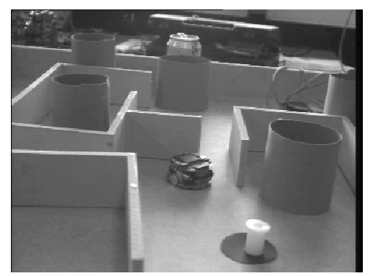
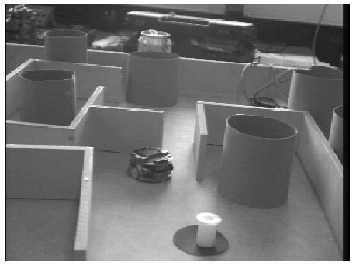
Background:
LEFT
RIGHT
Which two points are the projections of the same point in the real world?
Known the correspondence points, how to determine the 3-D coordinates of the points?
Correspondence Problem
Reconstruction Problem

Slide 3
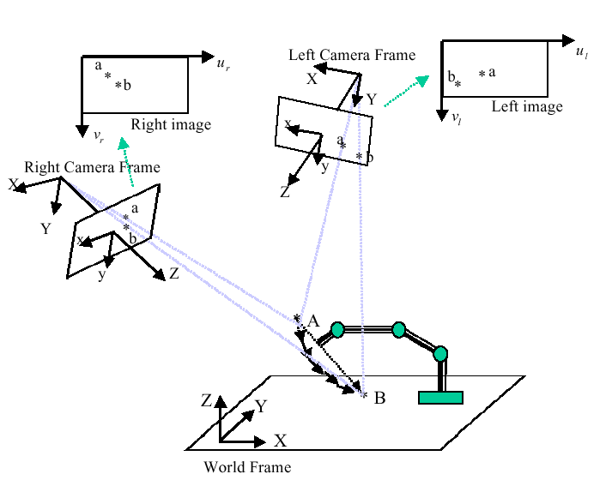
Problem Analysis:

Slide 4
Parameters of camera:
Extrinsic parameters:
۰Rotation matrix
۰translation vector
Intrinsic parameters:
۰Image center coordinates
۰Radial distortion coefficient

Slide 5
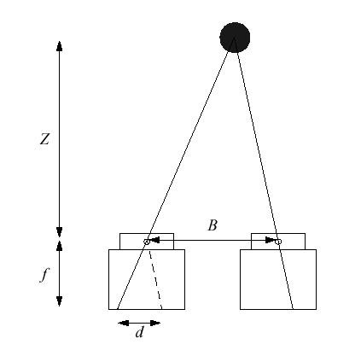
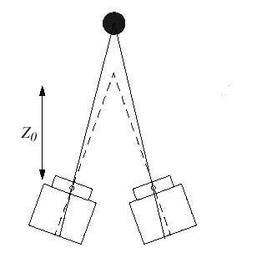
Disparity and Depth in Camera System:
d: Disparity
Z: Depth

Slide 6
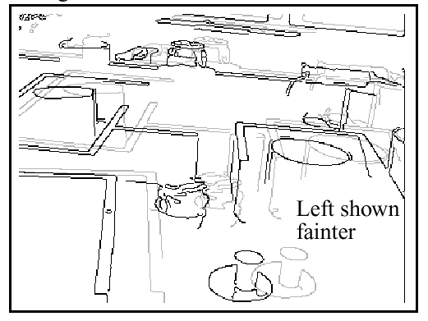

Correspondence Problem:
Aim: To measure disparity
What is disparity in image pair?
There is some separation between two matching objects
DISPARITY

Slide 7
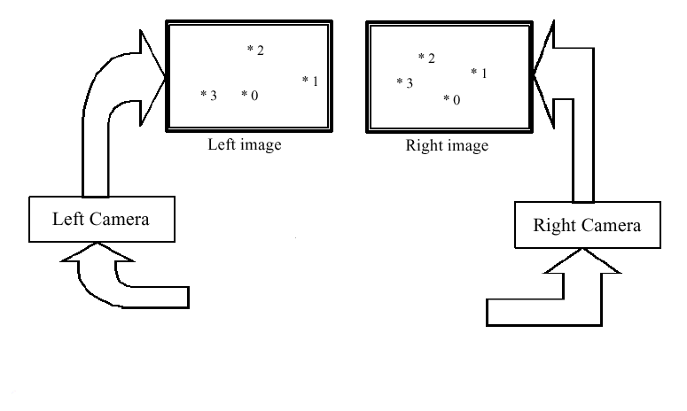
Correspondence Problem:

Slide 8
Correspondence Problem:
Principles:
۰Principle of Similar
۰Principle of Exclusive
۰Principle of Proximity
Two categories of approaches:
۰Correlation-based approach
۰Feature-based approach

Slide 9
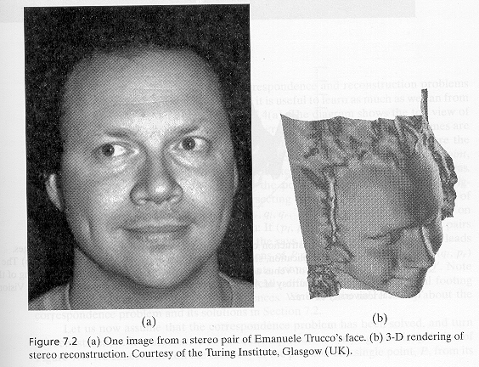
Reconstruction Problem

Slide 10
Reconstruction Problem:
Aim: To recover the depth information
Assumption:
Correspondence problem has been solved so that a sufficient set of correspondence points can be found.
Categories of Approaches (According to the camera parameters Obtained):
۰Reconstruction by epipolar geometry
۰Reconstruction from motion
۰Reconstruction from texture
۰Reconstruction from shade

Slide 11
Reconstruction from Epipolar Geometry

Slide 12
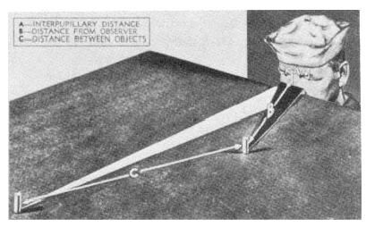
Epipolar Constraints:
The first image of any point must lie in the plane formed by its second image and the optical centers of the two camera

Slide 13
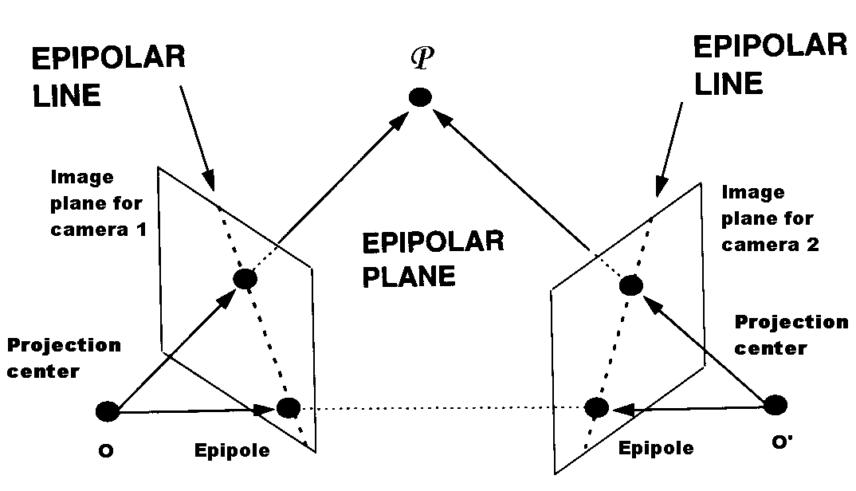
Epipolar Geometry:

Slide 14
Question:
How to determine the mapping between points in one image and epipolar lines in the other?
Basics:
The translation between O and O’: T
The relation between P((X^{(P)},Y^{(P)},Z^{(P)})) and P’((X^{(P)}’,Y^{(P)}’ ,Z^{(P)}’)):
P’=R(P-T) (1)
P=R^{T}P’+T (2)
The relation between a point’s three-dimensional coordinates in a camera space and the two-dimensional coordinates in the corresponding image plane
p=f*P/Z (3)
p’=f’*P’/Z’ (4)

Slide 15

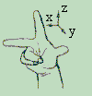


Essential Matrix:
In the real-world space coordinate system:
A point P and two projection centers O and O’ decide an epipolar plane, we have:
The triple product of these three vectors are ZERO
Triple Product: V = (A x B) • C
۰”x” is the cross product (vector product)
۰” •”: dot product (scalar product)
۰triple product is the volume of the parallelepiped formed by the three vectors
|A x B|= |A| |B|sin(Angle(A, B))

Slide 16
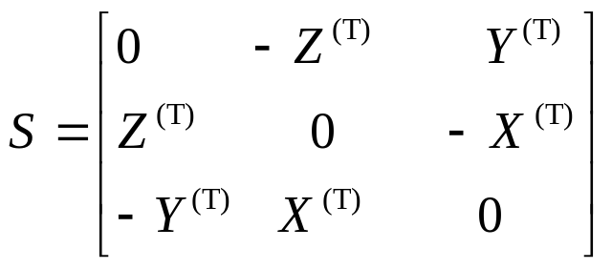
Essential Matrix(Contd.):
Coplanarity Condition in real world coordinate space:
((P-O)-(O-O’))^{T}(O-O’) x (P-O)=0 (5)
Rewrite it in the camera space coordinates:
(P-T)^{T} T x P=0 (6)
Introducing rotation matrix, we have:
(R^{T}P’)^{T} T x P=0 (7)
From the definition of cross production:
T x P=SP (8)

Slide 17
Essential Matrix(Contd.):
Let E=RS, we have:
P’^{T}EP=0 (9)
Dividing by ZZ’, it becomes:
p’^{T}Ep=0 (10)
E: Essential matrix.
۰It build a link between the epipolar constraint and the extrinsic parameters, i.e., the rotation matrix and the translation vector, of the stereo system
۰It is the mapping between points and epipolar lines, where u’=Ep is the project line

Slide 18
Fundamental Matrix:
If known the intrinsic parameters of the cameras, denote the matrices of the intrinsic parameters as M and M’ respectively. Then we have:
p_{im}=M⁻¹p (11)
p_{im}’=(M’)⁻¹p’ (12)
Similarly, we have:
(p_{im}’)^{T}FP_{im}=0 (13)
With: F=(M’)⁻¹EM⁻¹ (14)

Slide 19
Fundamental Matrix(Contd.):
F: Fundamental matrix.
۰The same as essential matrix, it also builds links between points and corresponding epipolar lines
۰Different from essential matrix, it is defined in terms of pixel coordinates, while essential matrix is defined in terms of camera coordinates
F establishes a mapping from the points to the corresponding epipolar lines with no prior knowledge of the stereo parameters

Slide 20
Eight-point algorithm:
Aim: To compute the essential matrix or the fundamental matrix
Method: Given 8 corresponding points to get a set of linear equations whose null-space are non-trivial
۰ If more than eight points are used, then the system is overdetermined. We can use SVD related techniques to get the solution
۰ The solution is unique up to a signed scaling factor
۰ Due to the noise, numerical errors and inaccurate correspondence, E and F are most likely nonsingular, then some singular constraints may have to be enforced.

Slide 21
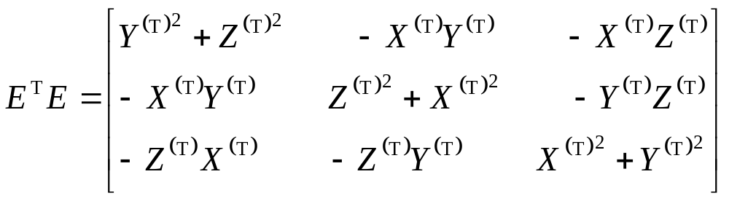

3-D Reconstruction:
Translation T calculation:
E^{T}E=S^{T}R^{T}RS (15)
So:
(16)
By normalize it, a unit translation vector can be found:

Slide 22
3-D Reconstruction(Contd.):
By a set of algebraic transformation, R can be determined by: r₁=w₁+ w₂ x w₃ (16)
r₂=w₂+ w₃ x w₁ (17)
r₃=w₃+ w₁ x w₂ (18)
Where e₁, e₂ and e₃ are rows of normalized essential matrix, T is the unit translation vector
e_{i}=T x r_{i} ( i=1, 2, 3) (19)
And w_{i} is:
w_{i}=e_{i} x T ( i=1, 2, 3) (20)

Slide 23
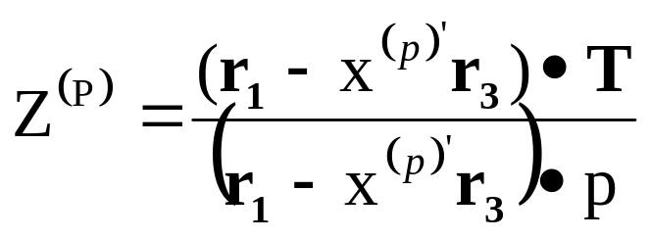
3-D Reconstruction(Contd.):
Assume the coordinates for a point in two image planes are
p=(x^{(p)},y^{(p)},1) and p’=(x’^{(p)},y’^{(p)},1)
Assume its corresponding coordinates in the three-dimensional space is
P=(X^{(P)},Y^{(P)},Z^{(P)}) and P’=(X’^{(P)},Y’^{(P)},Z’^{(P)})
Then:
(21)
And: X^{(p)}=x^{(p)}Z^{(p)}, Y^{(p)}=y^{(p)}Z^{(p)} (22)

Slide 24
Summary of the Algorithm:
Compute essential matrix E
Obtain the ratio of the components of translation T. Its relative signs are determined, but the absolute signs are selected arbitrary
Compute the rotation matrix
Compute the three dimensional coordinates for all visible points, and the set of three-dimensional coordinates in the other camera system are also obtained
Check the sign of the coordinates along the direction of both set of optical axis. If they are all positive, then the absolute signs of T are right, else they need to be altered.

Slide 25
Summary:
Advantage: simplicity of implementation
Disadvantage:it is extremely susceptible to noise and hence virtually useless for most purposes
Improvement: Preceding the algorithm with a very simple normalization (translation and scaling) of the coordinates of the matched points. (See reference 3)

Slide 26
Comparison with The Methods of Structure Reconstruction from Motion

Slide 27
Structure from Motion:
Projection Category:
Affine projection
Euclidean projection
۰Orthographic projection
۰Weak perspective projection
۰Paraperspective projection
Projective projection

Slide 28
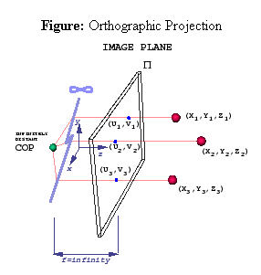
Orthographic Projection:
Tomasi and Kanade’s Factorization method:
Given: P corresponding points over F
frames
To find:
۰ Camera motion
۰Depth information
u=X; v=Y

Slide 29
Tomasi and Kanade’s Factorization
Stacking the P corresponding points from F frames, get a 2F x P matrix W
Recovering and factoring out the 2-D translation by letting the P points of each frame subtract off the mean of each frame, get a new 2F x P matrix W’
By perform SVD to W’:
W’ =RΣS
Get a description of W’ as the production of two matrix R₃ and D₃:
W’ = R₃D₃
where R₃ is 2F x 3, is the leftmost 3 columns of R and D₃ is 3 x P, is the topmost 3 rows of ΣS
R₃ is the camera motion and D₃ is the scene structure

Slide 30
References:
H.C.Longuet-Higgins, A Computer Algorithm for Reconstructing a Scene from Two Projections, Nature, Vol. 293, no. 10, pp.133-135(1981).
Emanuele Trucco, Alessandro.Verri, Introductory Techniues for 3-D Computer Vision,Prentice Hall, 1998
R.I.Hartley, In Defence of the 8-point Algorithm, Proc. 5th International Conference on Computer Vision, Cambridge(MA), pp.1064-1070 (1995)
http://www.cs.berkeley.edu/~daf/book3chaps.html

Slide 31
Term Definition:
P: A visible point in the scene
P((X^{(P)},Y^{(P)},Z^{(P)})) and P’((X^{(P)}’,Y^{(P)}’ ,Z^{(P)}’)): Three-dimensional Cartesian coordinates of point P in the two respective camera space
p((x^{(P)},y^{(P)})) and p’((x^{(P)}’,y^{(P)}’)): Two-dimensional coordinates of point P in the image planes with respective to the two cameras coordinates
p_{im}((x_{im}^{(P)},y_{im}^{(P)})) and p_{im}’((x_{im}^{(P)}’,y_{im}^{(P)}’)): Two-dimensional coordinates of point P in the image planes with respective to the real pixel coordinates
R: Rotation matrix (A unitary orthogonal matrix)
T: Translation vector
f and f’: Focal lengths of the two cameras
O and O’: Projection centers of the two cameras
(X ^{(P)},Y ^{(P)},Z ^{(P)}): The coordinates of point P in the world space coordinate system

